Slide 1
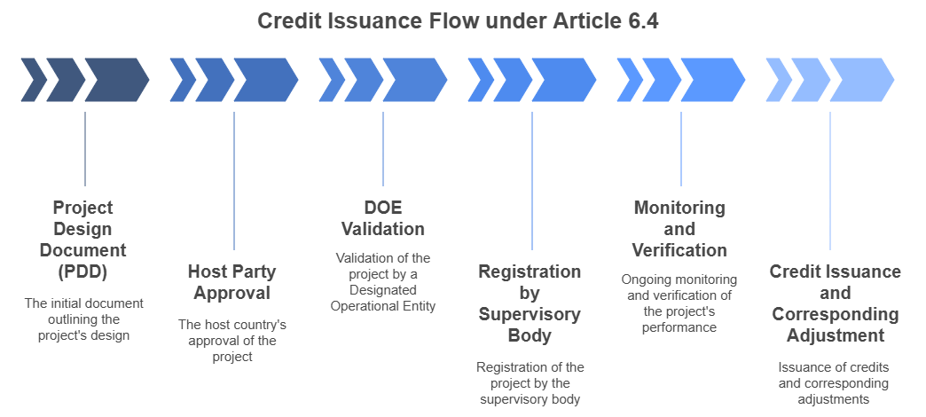

Slide 2
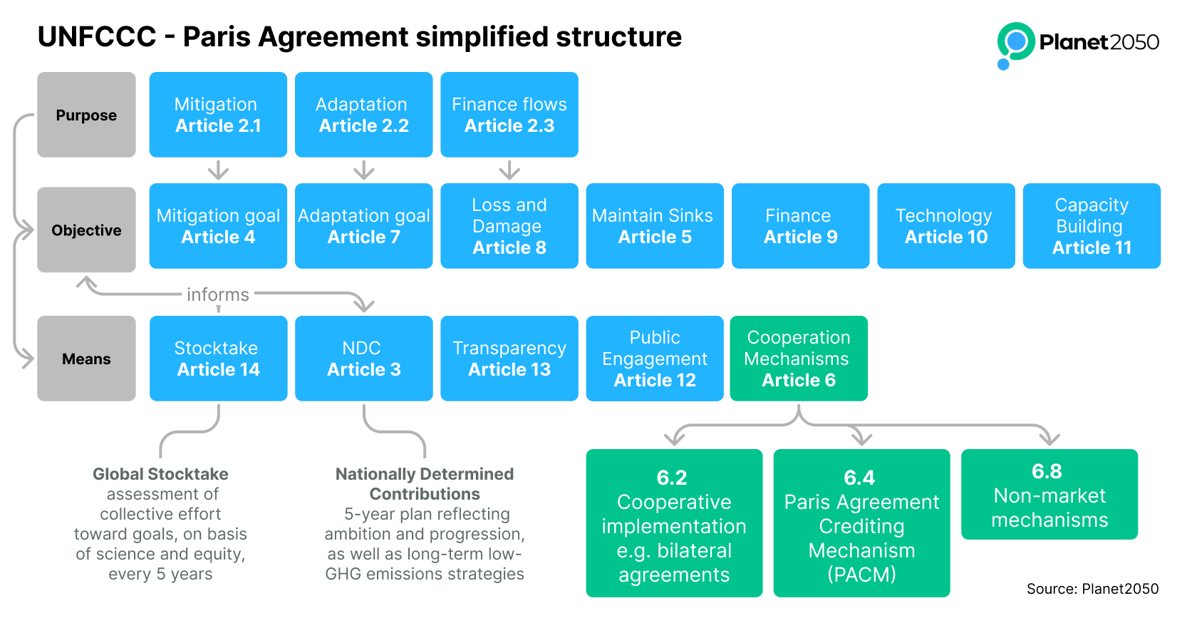

Slide 3
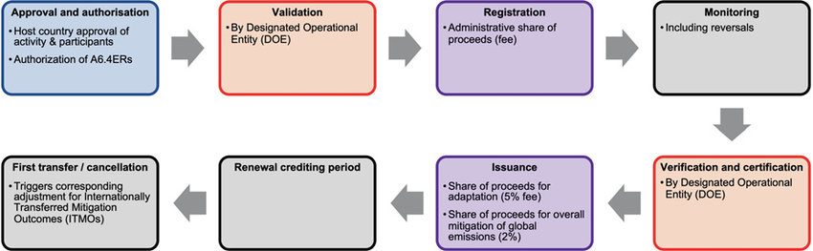

Slide 4
Project Life Cycle
Project Idea
Host Country Authorization
Methodology Selection / Development
Article 6.4 PDD
VVB Validation
Article 6.4 Registry Registration
Monitoring (MR)
VVB Verification
Issuance of A6.4ER
(Transfer / Use / Cancellation)

Slide 5
PDD 設計

Slide 6
BASIC INFORMATION
BASIC INFORMATION(1)
BASIC INFORMATION(1)
Project Title
UNFCCC project reference number
Host Party
Other participating Parties
Activity participant(s)
PDD version number
PDD completion date
Applied methodologies and standardised baselines, and their versions
Sectoral scope(s)
Type of the project
Estimated annual emission reductions or net removals over the crediting period (tCO₂e/year)

Slide 7
SECTION A. Project description
A.1. Project purpose and general description
A.2. Confirmation that the project aligns with the A6.4 activity types indicated by the host Party

